Slide 1
C3 topic2-Osmosis
Wenting Chai

Slide 2
Learning objectives
You should be able to:
Define osmosis.
Understand osmosis is an example of diffusion.
List 2 main differences between diffusion and osmosis, limited to types of molecules moving and presence of a partially permeable membrane.
Explain how plant roots absorb water.
Explain what happens when plant wilt.
Can correctly incorporate these terms when describing and explaining osmosis: shrink, swell, burst, (shriveled, swollen), osmosis, turgid, flaccid/ floppy, partially permeable (cell) membrane, water potential
State that plants are supported by the pressure of water inside the cells pressing outwards on the cell wall (which is turgor pressure)
Investigate and describe the effects on plant tissues of immersing them in solutions of different concentrations

Slide 3
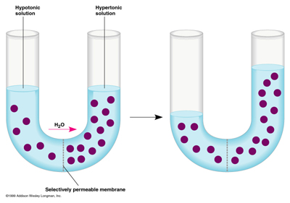
Water moves to right side (concentrated solution) by osmosis.
Q: Can I say water diffuse to right side?
Yes, sure it is correct, but not as good as mentioning osmosis.
Because osmosis means the diffusion of water through a partially permeable membrane which is exactly the case here.
Q: What if you remove the membrane here? Can you predict what will happen? How to explain?

Slide 4
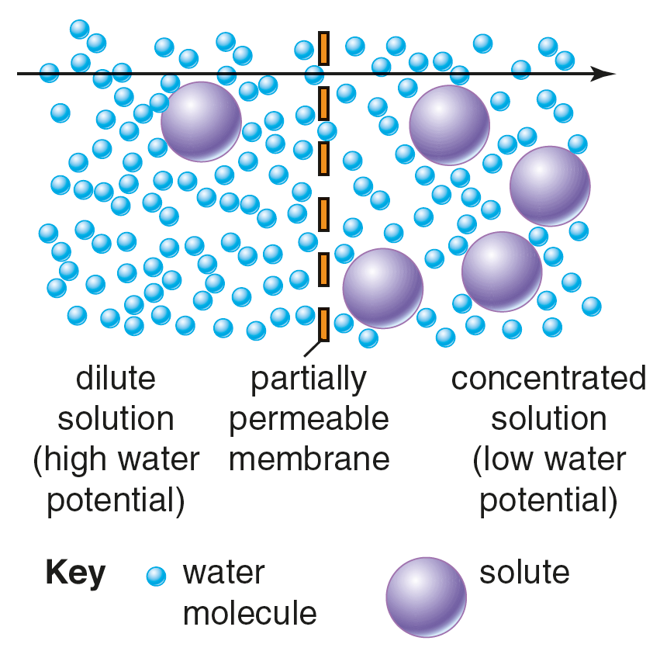
What is osmosis
Osmosis is the diffusion of water molecules from an area of high concentration to an area of low concentration across a partially permeable membrane
Partially permeable membranes have tiny holes in them.
Most solute particles are too large to pass through the partially permeable membrane, but water molecules can pass through.
Osmosis is very similar to diffusion but ONLY talks about the movement of water particles

Slide 5
What is osmosis?
Definition:
The movement of water molecules,
from a region of higher water potential (dilute/ weak solution) to a region of lower water potential (concentrated/ strong solution),
through a partially permeable membrane
Osmosis is the diffusion of water through a partially permeable membrane (which can be a cell membrane or other membranes or artificial Visking tubing) (where solutes usually cannot pass)
Notes:
Water potential: the tendency for water to leave a solution.

Slide 6
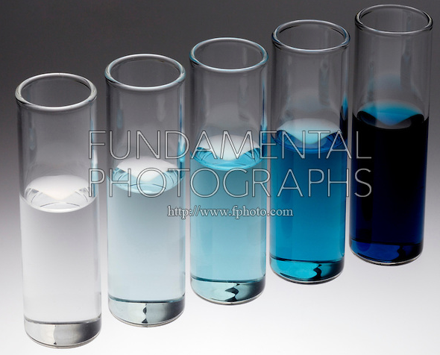
Water concentration
Water potential

Slide 7
Osmosis in Biology
Predict and explain what would happen if you put plant cells and animal cells in
a) concentrated solution;
b) dilute solution.
Use these words:
shrink/ shrivel, swell, burst, shriveled, swollen, osmosis, firm, turgid/ turgor pressure (only for plant), flaccid/ floppy, partially permeable membrane, water potential

Slide 8
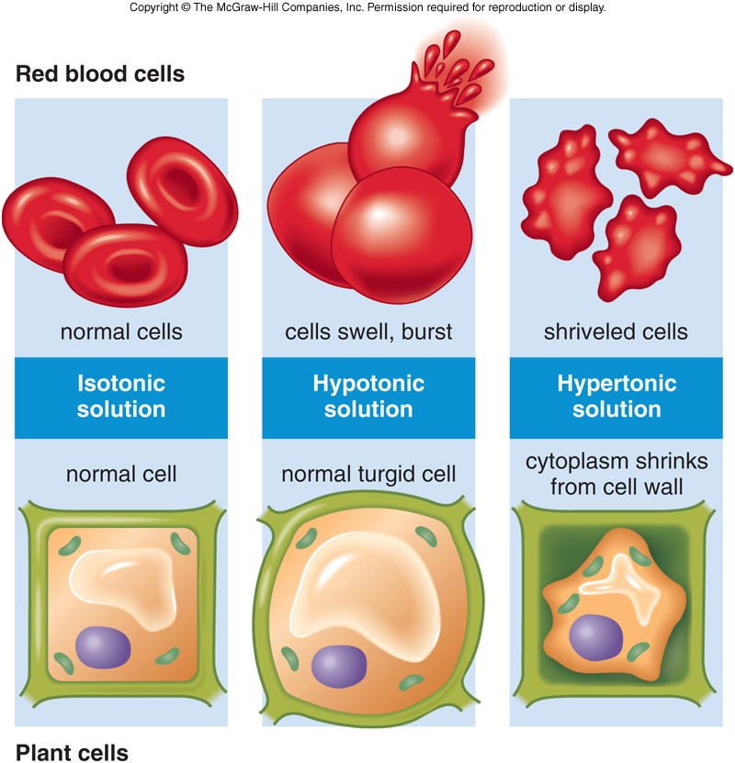
Osmosis in biology
Flaccid/ plasmolysed
turgid

Slide 9
Osmosis in animal cells
If there is not enough sugar in the blood plasma the water potential of the blood rises.
Water enters the red cells by osmosis. The red cells swell.
If there is too much sugar in the blood plasma the water potential of the blood falls.
Water leaves the red cells by osmosis. The red cells shrink.
Osmosis- A noun. Not a verb.
Water osmosis into/ out of cells???
No! Water move into/ out of cells by osmosis.

Slide 10
Plant cells cannot burst
If the water potential outside the cell is greater than inside the cell vacuole.
Water will enter the cell by osmosis.
The cell swells, gets slightly bigger and heavier.
The cell is described as turgid, rather like a blown-up tyre - tight and firm.
If the water potential outside the cell is less than inside the cell vacuole.
Water will leave the cell by osmosis.
The cell wall loses its turgidity and the cell inside shrinks. The cell gets slightly smaller and lighter.
The cell is described as flaccid.

Slide 11
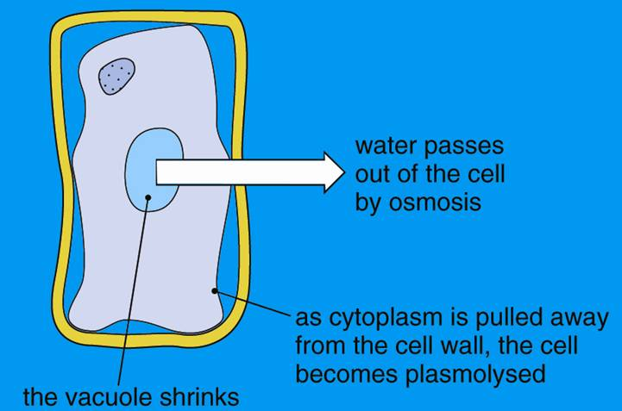
When plant cells are plasmolysed
plasmolysis

Slide 12
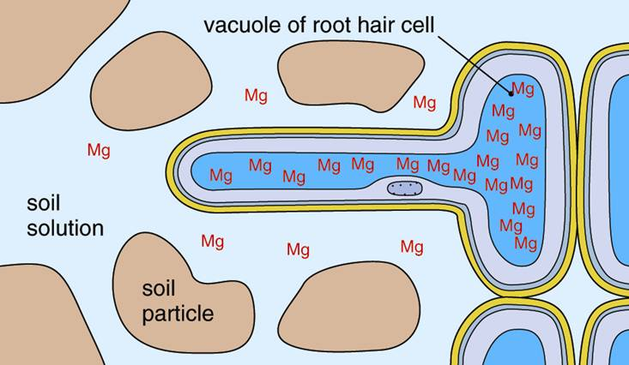
Osmosis at root hair cells
Q: How do plant roots absorb water?

Slide 13
Why wilting?
Q: When will plants wilt? Can you explain?

Slide 14
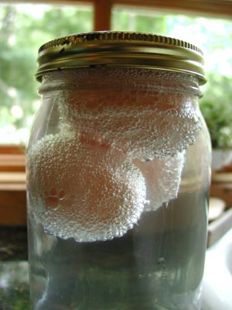
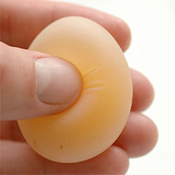
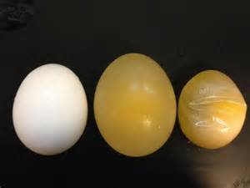
Egg membrane exposed
Dissolve the egg shell

Slide 15
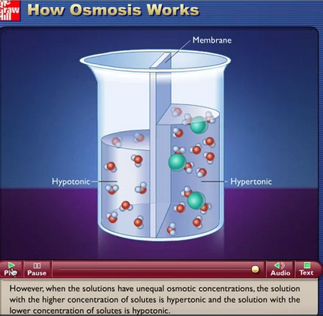
Lab videos
1. Animation of osmosis (VPN needed)
https://vimeo.com/145505696
2. Diffusion & osmosis (bozemanscience.com)
http://v.youku.com/v_show/id_XNDk0NjU3MTM2.html?from=s1.8-1-1.2
3. Osmosis Lab Walkthrough (potato) (bozemanscience.com)
http://www.schooltube.com/video/d85f41e82f8745c1afb1/Osmosis%20Lab%20Walkthrough

Slide 16
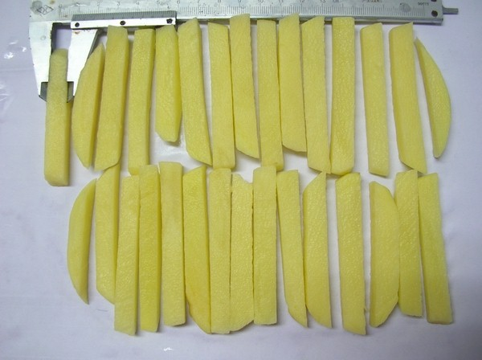
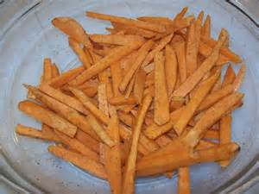
Investigation of osmosis
Task: Briefly outline an experiment plan that investigate the effects on plant tissue of immersing them in different solutions (osmosis). (e.g. NaCl solution or sugar solution)
Hint: You should consider questions below.
1. What is the hypothesis you are going to test?
2. What apparatus and other materials will you need for your experiment?
3. What variable will you vary/ change? How will you vary it?
4. What variables will you keep the same in all the tubes or beakers in your experiment? How will you do this?
5. What variable will you measure in your experiment? How will you measure it? When will you measure it? Will you do repeat measurements and calculate a mean?
6. How will you record your results? (You can sketch out a results chart, ready to fill in.)
7. What will your results be if your hypothesis is correct?
One of the materials we can use to study osmosis: potato strips
Q: Can we use fried potato strips?

Slide 17
Experiment/ Investigation
Step 1
Find a problem you need to solve
Step 2
Put forward a hypothesis
Step 3
Make a plan (consider independent and dependent variables, controlled variables, list of materials and apparatus, how should you record the data, design a results table)
Step 4
Carry out the plan
Step 5
Record the data
Step 6
Analyse and make a conclusion

Slide 18
How do you plan out an experiment
Activity 3.2 - How can temperature/ concentration gradient/ surface area affect the rate of diffusion? (work in pairs)
Please write out your experiment plan, including:
a heading and the hypothesis that you tested
a diagram of the apparatus that you used and a description of your method
Procedure/ steps (too much detail is not required, such as how you are going to prepare a solution)
a neat and carefully headed results table (no data filled) including means/ average if you decide to do repeats
List what is the independent variable, at least 3 standardised variables, dependent variable in your plan.
Hint: Consider the 7 questions mentions earlier.

Slide 19
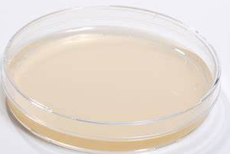
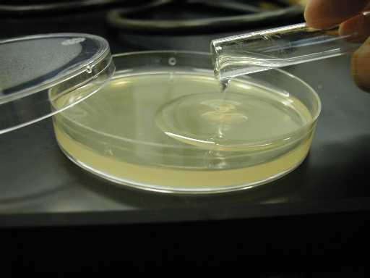
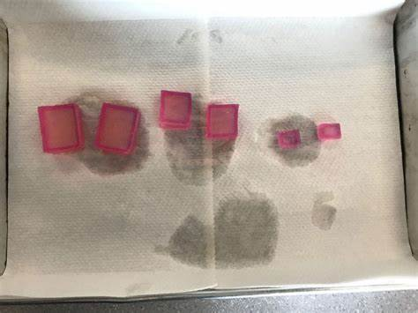
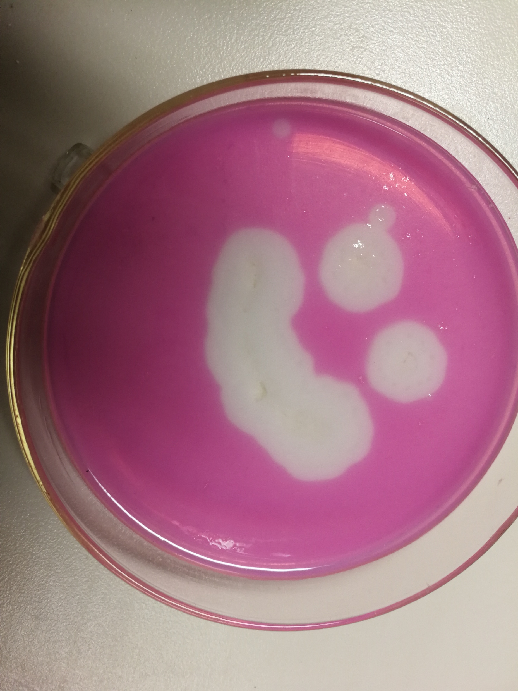
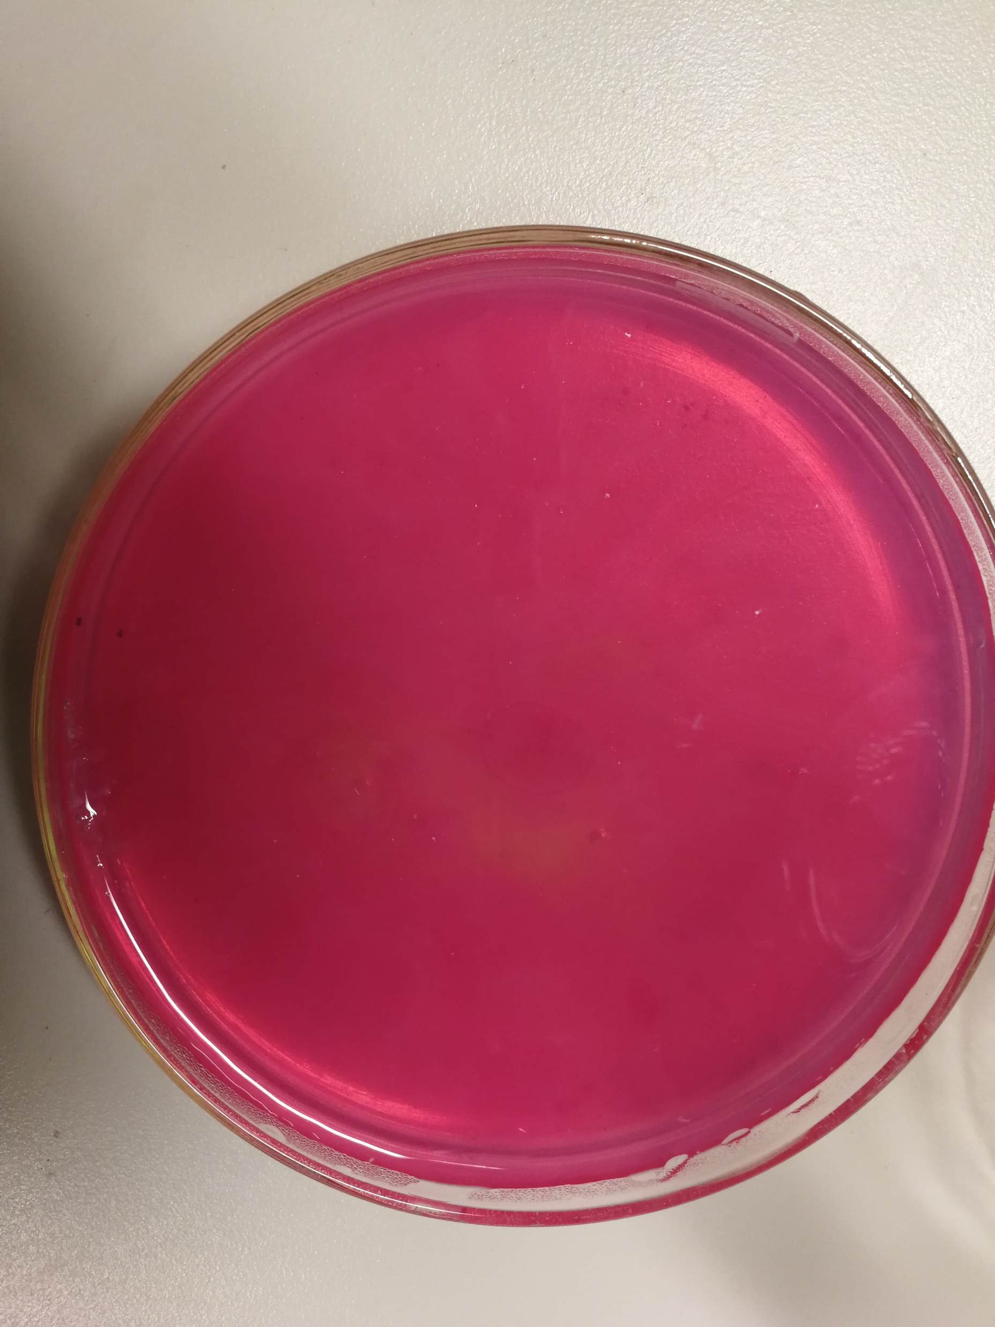
Materials you might use
Petri dish
Agar jelly
Agar is a chemical powder which can dissolve in hot water and become solid when it cools down.
You can cut into agar jelly cubes of different sizes.
(Phenolphthalein is a pH indicator, which is colorless below pH 8.5 and appears a pink to red hue above pH 9.)
Phenolphthalein + NaOH is added into agar.
Q: How can you make this happen?

Slide 20
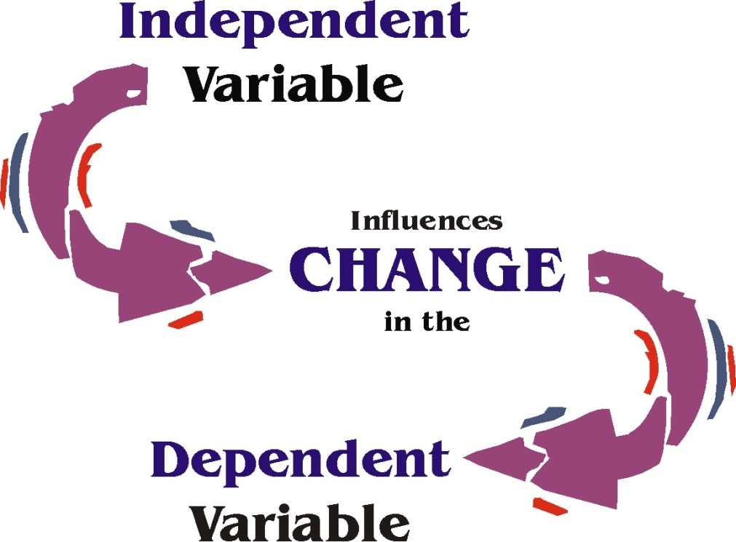
Variables
Variable: any factor that can be controlled, changed, or measured in an experiment.
There are 3 types of variables involved: independent variable , dependent variable, standardised/ controlled variable.

Slide 21
Variables
Independent variable: this is the factor whose values you change.
-- That is, a range of temperatures.
Standardized variable/ Controlled variable: other variables that might affect the results need to be kept constant.
-- That is, the volume of water, the type/ concentration/ volume of chemicals you use, etc.
Dependent variable: this is the only one variable you measure when you collect your results.
-- That is, the rate of diffusion (you might use different methods).

Slide 22
Experiment error
Source of experiment error: are unavoidable limitations of your apparatus, measuring instruments, experimental technique or experimental design that prevent your results from being totally reliable.
E.g. judging the start/end-point of color change, or the difficulty in keeping temperature using constant in some experiment.
Remember, they are not the mistakes you have made, such as not measuring out the right volume of solution, etc (these are avoidable mistakes and you should not be making them).

Slide 23
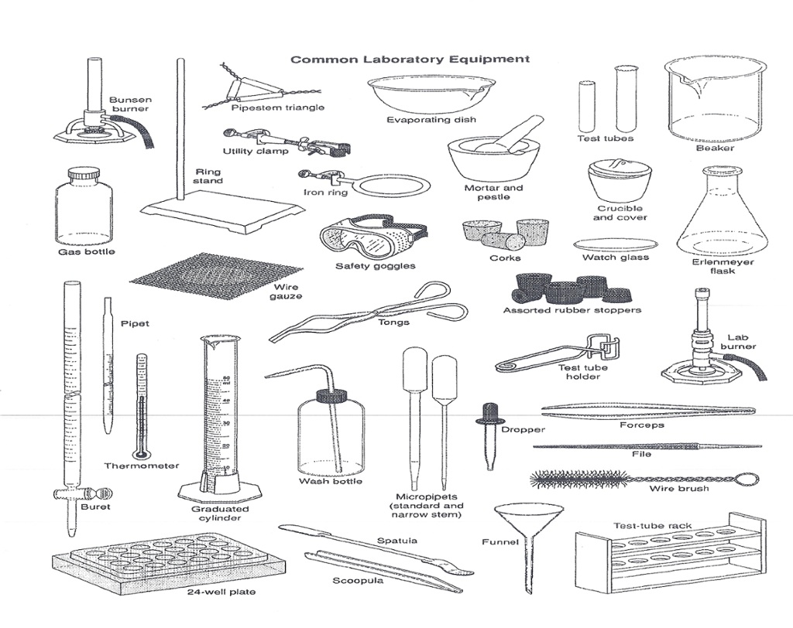
Common laboratory apparatus

Slide 24
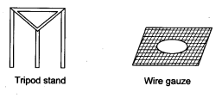
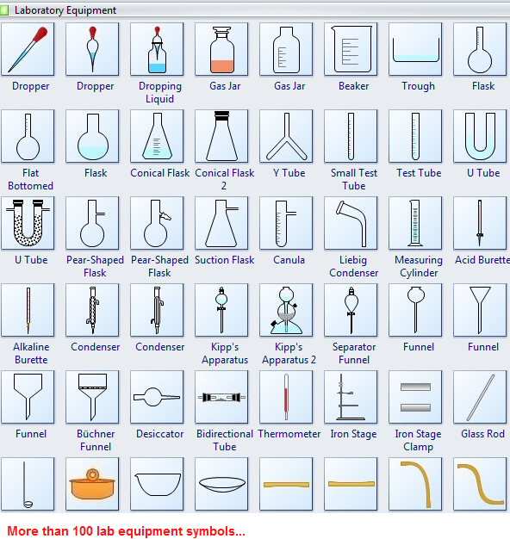
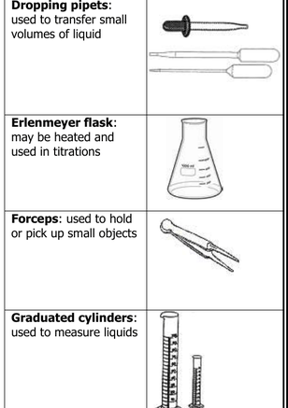
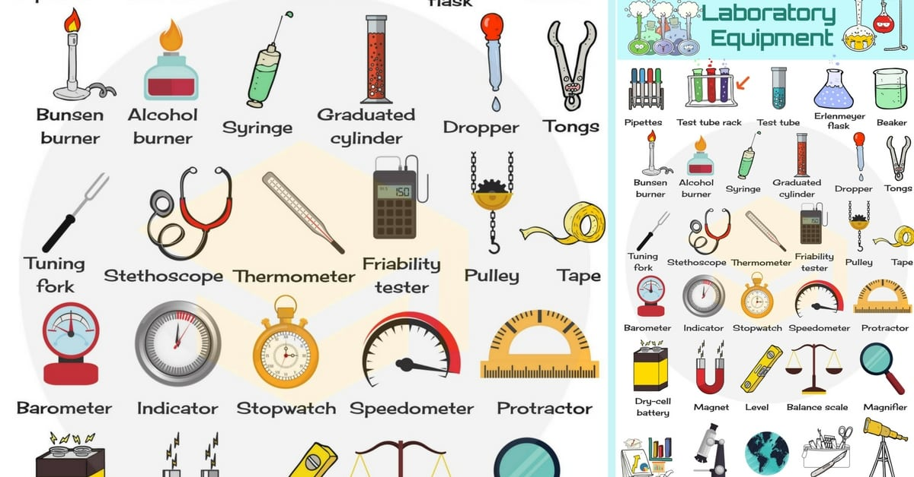
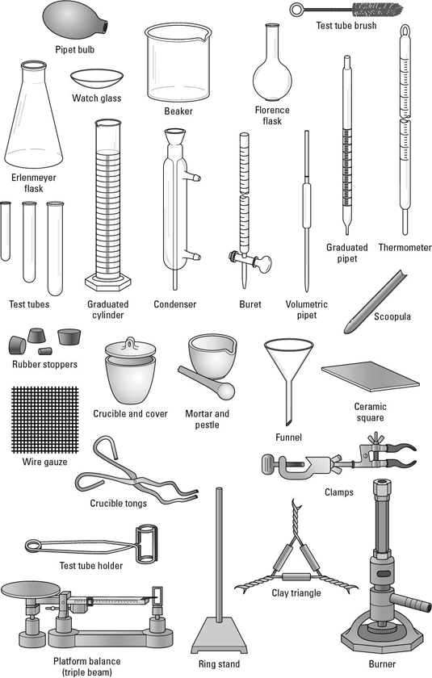

Slide 25
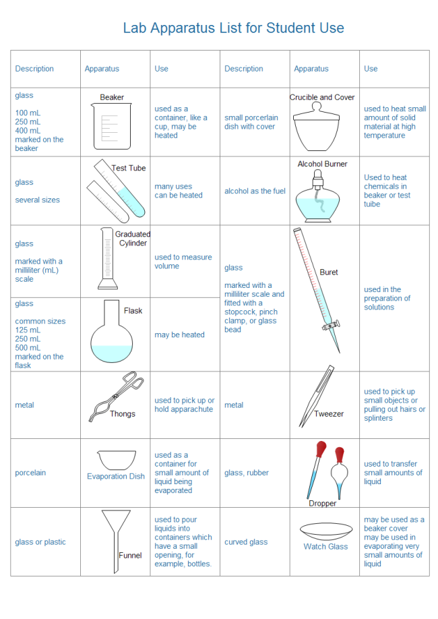

Slide 27
